Slide 1
Vesicoureteral reflux
Fahimeh Kazemi Rashed
kazemirashedf@yahoo.com
Tabriz University of Medical Sciences

Slide 2
Vesicoureteral reflux
What is vesicoureteral reflux (VUR)?
Who gets VUR?
What are the types of VUR?
What are the symptoms of VUR?
What are the complications of VUR?
How is VUR diagnosed?
What other tests do children with VUR need?
How is primary VUR treated?

Slide 3
Learning objectives
Upon completion of this activity, participants should be able to:
Describe the prevalence of vesicoureteral reflux (VUR) in the general pediatric population and in children with urinary tract infections.
Describe the grading system of the International Reflux Study for classification of VUR.
Describe the inheritance pattern of VUR and guidelines for its management.
Identify the most reliable tests for the diagnosis of VUR.
Describe the techniques and efficacy of surgery for the management of VUR.

Slide 4
Background, incidence and etiology
VUR is the retrograde flow of urine from the bladder into the ureter.
It occurs in approximately 1–3% of children and is associated with 7–17% of children diagnosed with end-stage renal disease worldwide.
Treatment of VUR is aimed at preventing the sequelae of pyelonephritis, renal parenchymal injury, hypertension, and chronic renal insufficiency.
A period of 30–40 years can pass between the first renal-scarring pyelonephritis and the development of hypertension or end-stage renal disease

Slide 5
Background, incidence and etiology
An estimated 30–40% of children under the age of 5 years who develop a urinary tract infection (UTI) have VUR
VUR can be further categorized as either primary or secondary.
Primary VUR in children is frequently attributed to an abnormally short intravesical tunnel at the ureterovesical junction
Secondary VUR occurs when reflux is induced by abnormally increased bladder pressures, such as those seen with urethral obstruction or neurogenic bladder dysfunction.

Slide 6
Risk factors
Factors associated with VUR include the following:
A short submucosal tunnel
Lateral placement of the ureteral orifice
Abnormal configuration of ureteral orifice (e.g., stadium, horseshoe , and golf-hole orifices)
Infection
Severe bladder-outlet obstruction
Young age
Duplicated collecting systems (particularly from the more laterally placed orifice draining the lower pole)

Slide 7
bladder submucosal tunnel
Lateral placement of the ureteral orifice

Slide 8
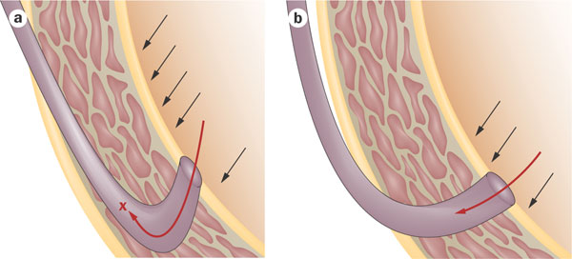
Diagram of the bladder submucosal tunnel
short submucosal tunnel
Cooper, C. S. (2009) Diagnosis and management of vesicoureteral reflux in children
Nat. Rev. Urol. doi:10.1038/nrurol.2009.150

Slide 9
Normal orifice

Slide 10
Horse shoe orifice
Abnormal configuration of ureteral orifice

Slide 11
Golf hole orifice
Abnormal configuration of ureteral orifice

Slide 12
predictive of reflux resolution and/or the risk of renal injury
In general, the severity or grade of VUR has been used as the main factor to determine the likelihood of spontaneous reflux resolution and risk of renal injury.
Other factors include age, sex, laterality, bladder volume and pressure at the onset of reflux, presence of renal scars, presence of voiding dysfunction, and a history of UTI.

Slide 13
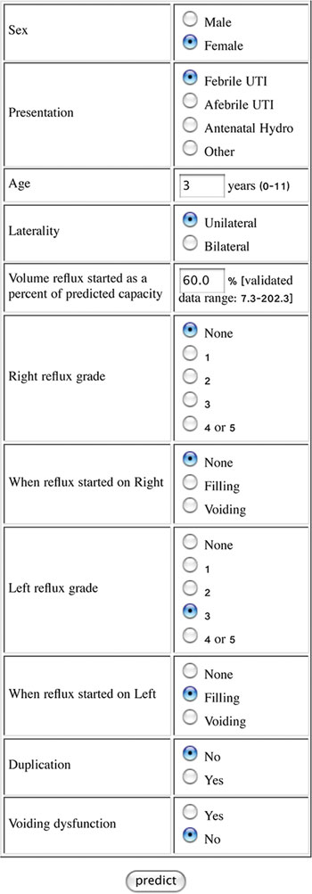
Figure 7 User interface of a neural network for predicting the chance and timing of spontaneous resolution of vesicoureteral reflux based on a 2‑year resolution model
Cooper, C. S. (2009) Diagnosis and management of vesicoureteral reflux in children
Nat. Rev. Urol. doi:10.1038/nrurol.2009.150

Slide 14
Background, incidence and etiology
strong inheritance pattern exists for primary VUR
The chance of a sibling of a child with VUR also having reflux is about 25%, and the offspring of affected individuals have a 27–51% increased risk of having reflux.
appropriate clinical assessment and management of children with VUR requires the treating physician to develop an individualized approach that considers multiple factors.

Slide 15
Clinical management
Antibiotics versus operative intervention
no significant differences exist in renal function or growth, the progression or development of new scars, or UTIs in patients treated with one intervention compared to the other.
Pyelonephritic symptoms, including febrile UTIs, tended to be more common in the medically treated groups compared with the surgical groups

Slide 16
Clinical management
new scars occurred earlier in children treated surgically compared with those in the medical treatment groups, but, as noted, no significant difference occurred overall with longer follow-up in terms of new renal scars in those treated with antibiotics compared to those undergoing surgery.
nine re-implantation procedures would be required in order to prevent one incidence of febrile UTI, with no reduction in the number of children developing any UTI or renal damage.

Slide 17
Clinical management
Antibiotics versus observation
Antibiotic prophylaxis for reducing the likelihood of developing a UTI has been associated with a 24-fold increased risk of Escherichia coli developing resistance to trimethoprim–sulfamethoxazole.
antibiotic prophylaxis has not been proven to reduce the incidence of pyelonephritis in children with VUR.

Slide 18
Clinical evaluation
Assessment of reflux
The only tests that routinely and reliably detect reflux are voiding cystourethrography (VCUG) and nuclear cystography.
An initial VCUG provides better anatomic details regarding reflux, including the presence or absence of periureteral diverticuli, ureteral duplication, and abnormalities of the bladder, such as trabeculations or urethral obstruction.
Typically, follow-up studies are performed with nuclear cystography, as there is a decreased exposure to radioactivity with this study.

Slide 19
Clinical evaluation
Assessment of renal scars

Slide 20
Diagnostic work-up
basic diagnostic work-up comprises :
detailed medical history (including family history, screening for LUTD),
physical examination including blood pressure measurement,
urinalysis (including proteinuria), and
urine culture.

Slide 21
Diagnostic work-up
The choice of imaging modalities varies depending on the mode of presentation.

Slide 22
Diagnostic work-up
The use of VCUG is recommended :
In patients with US findings of bilateral high-grade hydronephrosis,
duplex kidneys,
ureterocele,
ureteric dilatation and
abnormal bladders, as the likelihood of VUR is much higher.
In all other conditions, the use of VCUG to detect reflux is optional

Slide 23
Grading of reflux

Slide 24
Grading of reflux

Slide 25
Grade 1

Slide 26
Grade 2

Slide 27
Grade 3

Slide 28
Grade 4

Slide 29
Grade 5

Slide 30
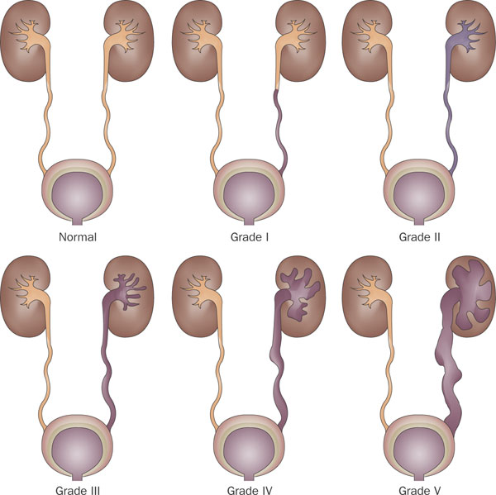
International Reflux Grading System
Cooper, C. S. (2009) Diagnosis and management of vesicoureteral reflux in children
Nat. Rev. Urol. doi:10.1038/nrurol.2009.150

Slide 31
Grade I- ureter only

Slide 32
Grade II-Ureter, pelvis, calyces, no dilation, normal calyceal fornices

Slide 33
Grade III-Mild or moderate dilation and/or tortuosity of the ureter, and mild or moderate dilation of the pelvis, but no or slight blunting of the fornic

Slide 34
Grade IV- Moderate dilation and/or tortuosity of the ureter and mild dilation of renal pelvis and calyces; complete obliteration of sharp angle of fornices but maintenance of papillary impressions in majority of calyces, but no or slight blunting

Slide 35
Grade V- Gross dilation and tortuosity of ureter; gross dilation of renal pelvis and calyces; papillary impressions are no longer visible in majority of calyces

Slide 36
Treatment
There are mainly two treatment approaches
Conservative
Interventional

Slide 37
Spontaneous Resolution
Low Grade
Grade I…………………………….. 82% at 5 years
Grade II……………………………..80% at 5 years
Intermediate Grade – III……50% at 5 yrs
Grade IV……………………………25% at 5 yrs
Grade V…………………………….12% resolution

Slide 38
Spontaneous Resolution
Grade III & IV management presents the most controversy

Slide 39
Spontaneous Resolution
Age at diagnosis
Younger children are more likely to have VUR
VUR is more likely to resolve in younger children
Intervals of significant growth and beneficial urodynamic change are most likely to effect change
Resolution usually occurs within the first few years after diagnosis
Rarely resolves if continued reflux after 5 y

Slide 40
Management Decision Making
Spontaneous resolution of VUR occurs in many infants and children - rarely at puberty
More severe grades are less likely to resolve
Sterile reflux does not appear to cause significant nephropathy
Extended courses of prophylactic antibiotics are well tolerated by children
Anti-Reflux surgery is highly successful in capable hands
95-99% success rate

Slide 41
Management Decision Making
Medical management initially recommended for prepubertal children with I, II, III
This also may be true for Grade IV - esp. in younger children with unilateral disease
If no trend in improvement is seen in 2 - 3 years, surgery is recommended
Grade V is unlikely to resolve and surgery is recommended after infancy
Observation may be reasonable if diagnosed perinatally

Slide 42
Management Decision Making
Surgery recommended in most girls with persistent VUR
Implications for future pregnancies
Especially if recurrent infections or scars present
Some discontinue antibiotics at puberty in girls
Surgery if UTI occurs
Prophylaxis can be stopped at puberty in boys
Less likely to develop UTIs

Slide 43
Conservative therapy
The objective of conservative therapy is prevention of febrile UTI
It is based on the understanding that:
VUR resolves spontaneously, mostly in young patients with low-grade reflux; 81% and 48% in VUR grades I-II and III-V, respectively
VUR does not damage the kidney when free of infection

Slide 44
Conservative therapy
The conservative approach includes:
watchful waiting,
intermittent or continuous antibiotic prophylaxis
bladder rehabilitation in those with LUTD
Circumcision during early infancy may be considered as part of conservative approach

Slide 45
Conservative therapy
The most used antibacterial agents for prophylactic treatment are :
nitrofurantoin (in children > 3 months: 1-2 mg/kg/day, orally)
trimethoprim (in children > 3 months:2mg/kg/day, orally)
In the first 3 months of life, when these agents are poorly absorbed from the gut, amoxycillin (15 mg/kg/day, orally

Slide 46
Surgical Management: Indications for Surgery
Breakthrough UTIs on prophylactic antibiotics
Noncompliance with medical management
Severe VUR (Grade IV & V), especially with pyelonephrotic changes (evidence of scarring)
Failure of renal growth, new renal scars, or deterioration of renal function on serial studies
Persistent VUR in girls at puberty
Reflux associated with congenital abnormalities at the UVJ (e.g. bladder diverticulum)

Slide 47
Surgical Principles of Reflux Correction
Exclusion of causes of ………………………. . Secondary VUR
Mobilization of the ureter ……………Without tension or damage to blood supply
Creation of a submucosal tunnel……..5:1 ratio
Entry point of the ureter (hitus), the direction of the submucosal tunnel ureteromucosal anastomosis…………Stenosis, angulation, or twisting of the ureter
Muscular backing of the ureter ………Effective antireflux mechanism Gentle
Handling of the bladder ……………….Hematuria and bladder spasms

Slide 48
Gil-Vernet Technique

Slide 49
Post-Operative Care & Evaluation
Renal U/S
6 weeks
VCUG
3-6 months
Periodic F/U
18 months, 3 years, 5 years
check U/A, BP, U/S

Slide 50
Early Complications
Reflux
Contralateral or ipsilateral ureter
Trigonal edema, bladder dysfunction
Majority are low grade
Obstruction
Edema, spasms, blood clots
Most are mild
Occur 1-2 weeks post-op - pain, N/V, rarely fever
Renal scan shows delay in excretion
Nephrostomy tubes or ureteral stents if symptoms persist

Slide 51
Late Complications
Reflux
Short length to diameter ratio
Weak muscular backing
Failure to treat secondary causes of VUR
CIC and anticholinergics
Treatment of dysfunctional voiding
Obstruction
Complete obstruction
Ischemia or hiatal angulation
Intermittent obstruction
Lateral placement of orifice obstructs with filling

Slide 52
Interventional treatment
endoscopic injection of bulking agents

Slide 53
endoscopic injection of bulking agents
With the availability of biodegradable substances, endoscopic subureteric injection of bulking agents has become an alternative to long-term antibiotic prophylaxis and surgical intervention in the treatment of VUR in children.

Slide 54
bulking agents :
polytetrafluoroethylene (PTFE or Teflon),
collagen,
autologous fat,
polydimethylsiloxane,
silicone,
chondrocytes and,
more recently, a solution of dextranomer/hyaluronic acid (Deflux).

Slide 55
bulking agents :
bulking agents
dextranomer/hyaluronic acid (Deflux) was FDA-approved for the treatment of VUR in children.

Slide 56
Results of Endoscopic anti-reflux procedures
Reflux resolution rate (by ureter) following one treatment:
grades I and II………………78.5%,
grade III……………………….72%,
grade IV………………………63%
grade V……………………….51%.
If the first injection was unsuccessful, the second treatment had a success rate of 68%, and the third treatment 34%

Slide 57
Results of Endoscopic anti-reflux procedures
The aggregate success rate with one or more injections was 85%.
The success rate was significantly lower for duplicated (50%) versus single systems (73%),
neuropathic (62%) versus normal bladders (74%).

Slide 59
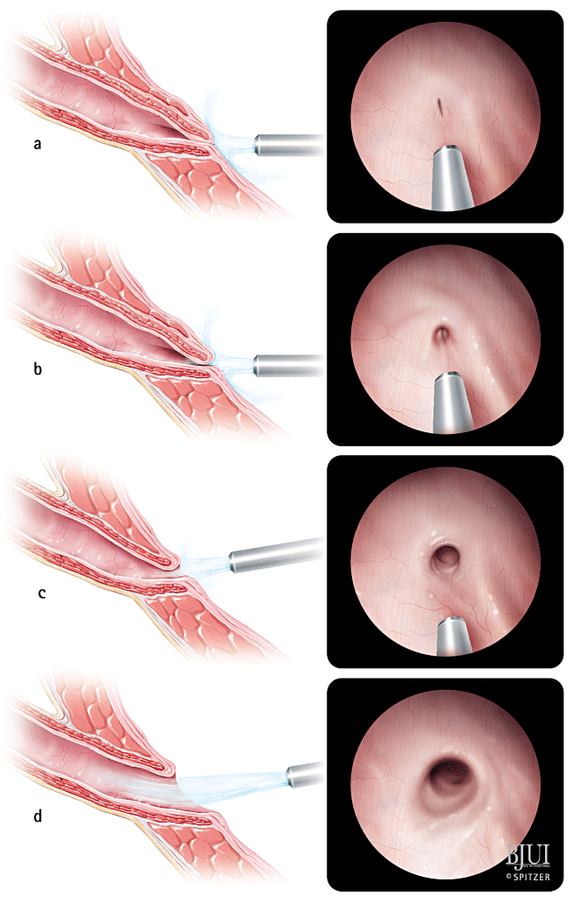

Slide 68
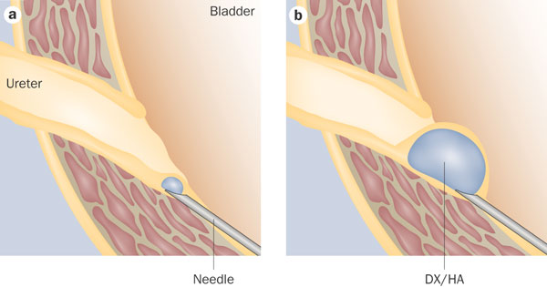
Endoscopic injection for vesicoureteral reflux. reproduced from Deflux® patient education brochure (Q‑Med, Uppsala, Sweden)
Cooper, C. S. (2009) Diagnosis and management of vesicoureteral reflux in children
Nat. Rev. Urol. doi:10.1038/nrurol.2009.150

Slide 69
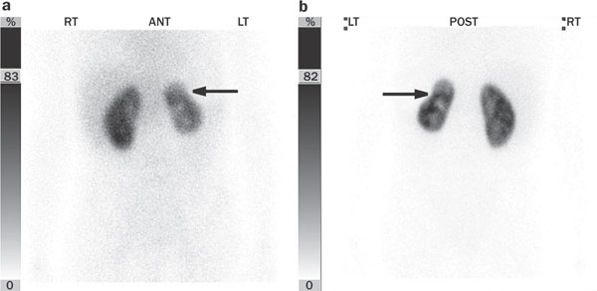
Figure 4 Dimercaptosuccinic acid scintigraphy with single photon emission computed tomography imaging demonstrating a cortical defect in the upper pole of the left kidney
Cooper, C. S. (2009) Diagnosis and management of vesicoureteral reflux in children
Nat. Rev. Urol. doi:10.1038/nrurol.2009.150

Slide 70
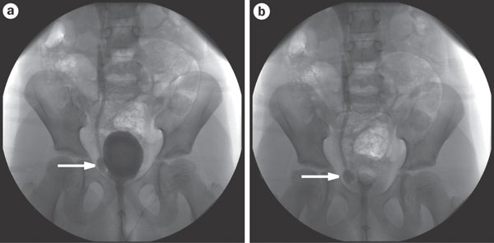
Voiding cystourethrogram, demonstrating right‑sided reflux with a periureteral diverticulum (arrows)
Cooper, C. S. (2009) Diagnosis and management of vesicoureteral reflux in children
Nat. Rev. Urol. doi:10.1038/nrurol.2009.150

Slide 71
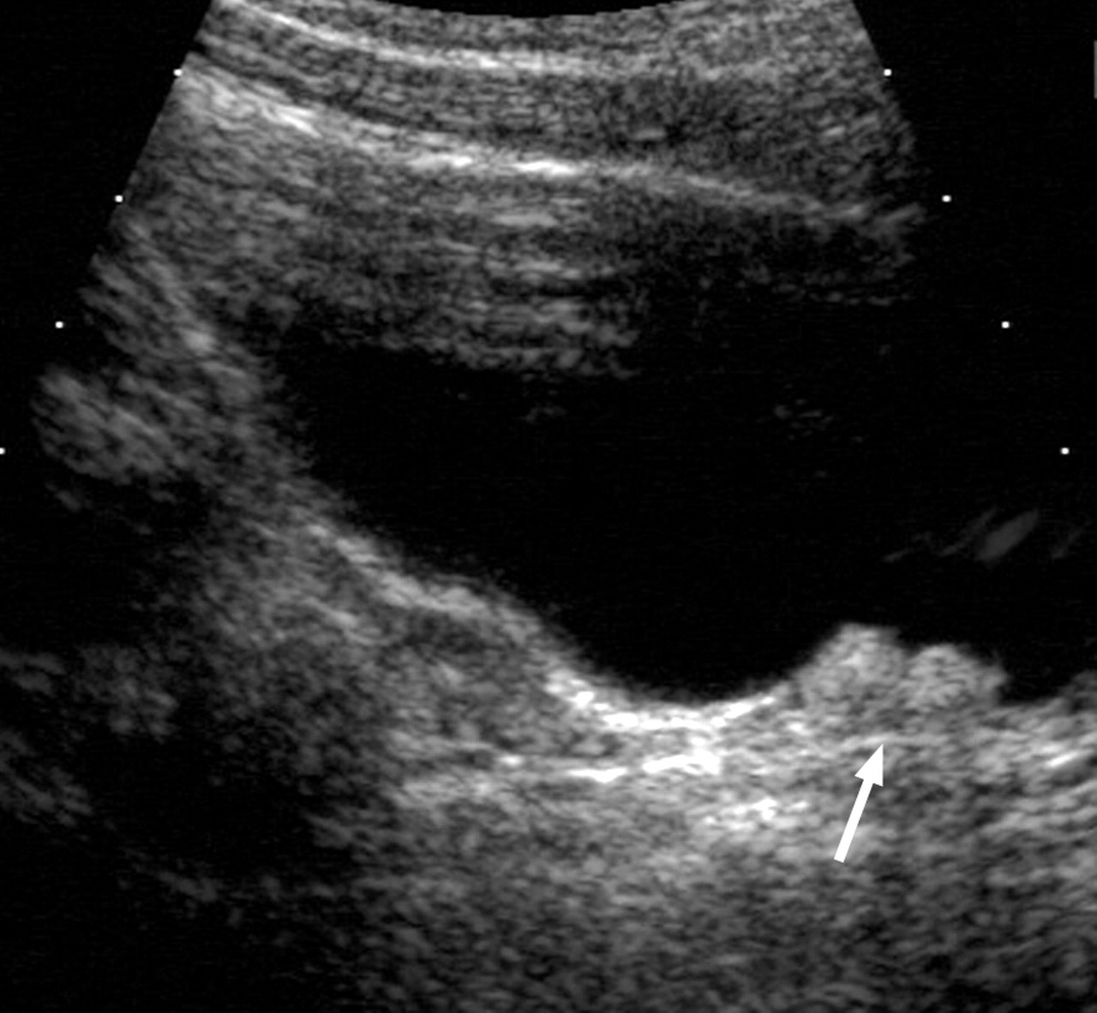
Sonograms of bladder demonstrate right-sided bilobed subureteric chondrocyte mound (arrow).
Paltiel H J et al. Radiology 2004;232:390-397
©2004 by Radiological Society of North America
Notes:
Figure 3b. Sonograms of bladder demonstrate right-sided bilobed subureteric chondrocyte mound (arrow). (a) Transverse image, with unilobed (arrowhead) left-sided mound. (b) Right sagittal image.

Slide 72
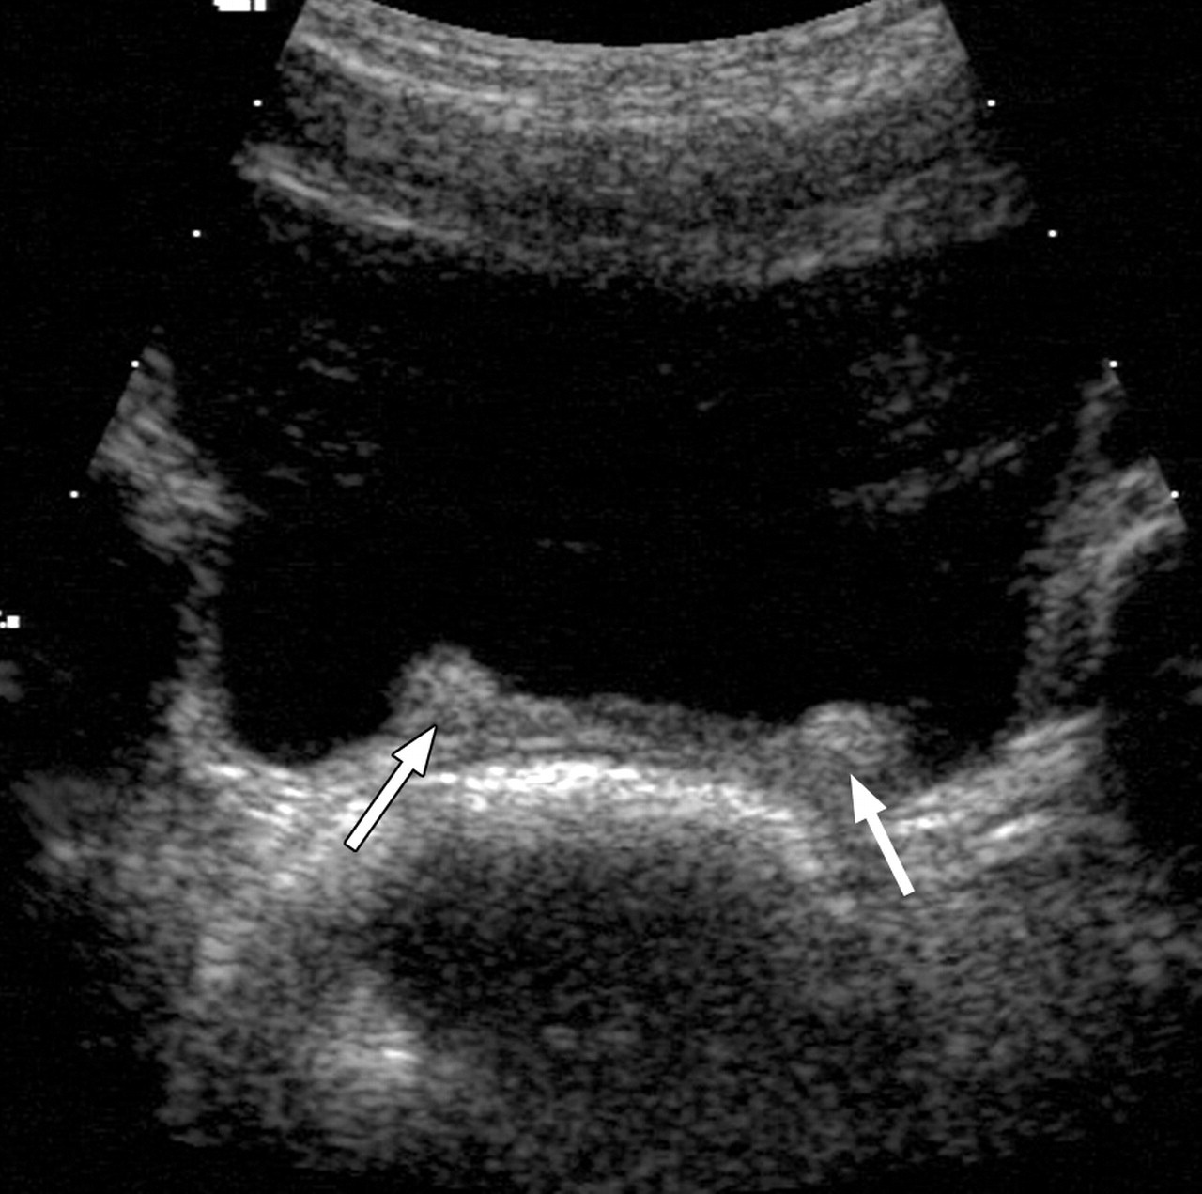
Transverse sonogram of bladder depicts bilateral unilobed subureteric chondrocyte mounds (arrows).
Paltiel H J et al. Radiology 2004;232:390-397
©2004 by Radiological Society of North America
Notes:
Figure 2. Transverse sonogram of bladder depicts bilateral unilobed subureteric chondrocyte mounds (arrows).

Slide 74
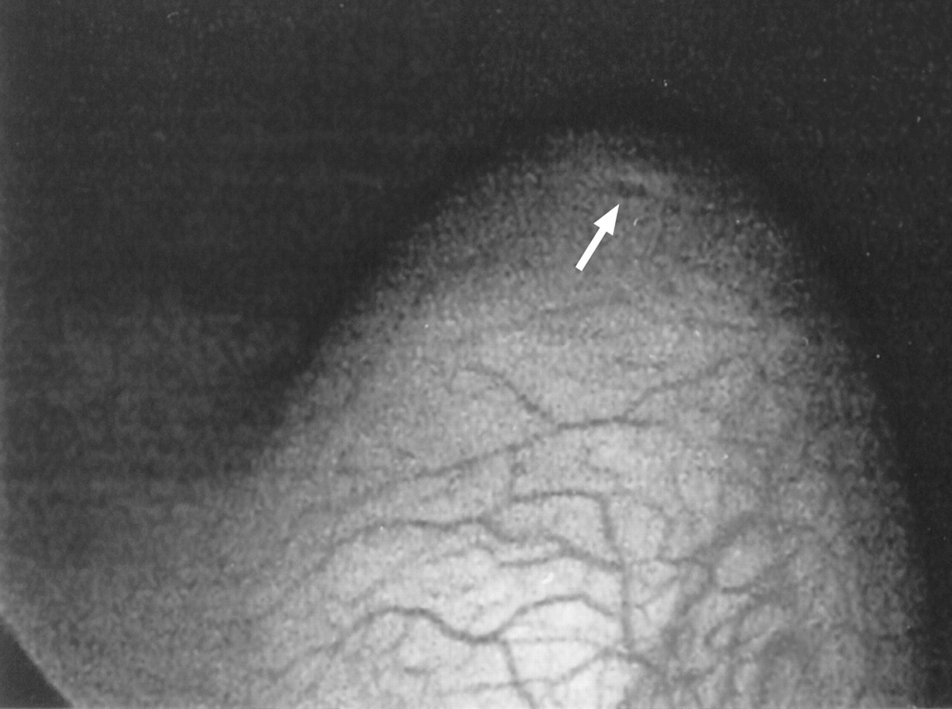
Figure 1b. Endoscopic images demonstrate ureteral orifice (arrow) (a) prior to and (b) following chondrocyte injection.
Paltiel H J et al. Radiology 2004;232:390-397
©2004 by Radiological Society of North America
Notes:
Figure 1b. Endoscopic images demonstrate ureteral orifice (arrow) (a) prior to and (b) following chondrocyte injection. Postinjection image shows elevation of ureteral orifice and diminution of its caliber.

Slide 75
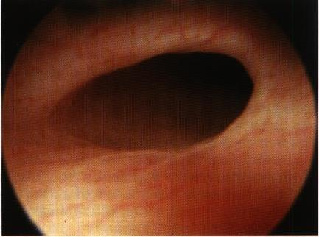

Slide 77
Thank you

